Slide 1
LRC Tutoring & Net Tutor Overview
Prepared for
SSCC Meeting
September 21, 2020

Slide 2
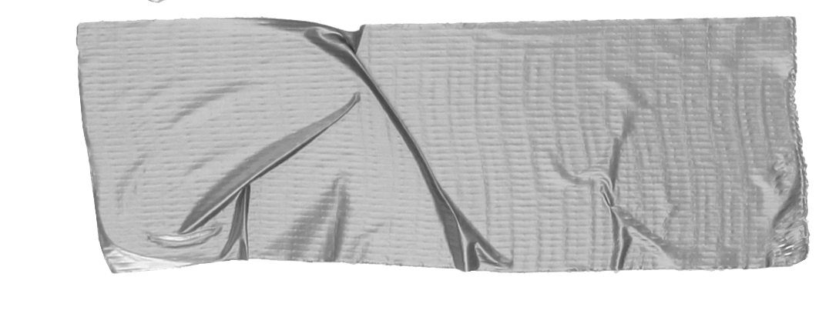
Overview
-Subjects available for tutoring
-Number of tutors available for drop-in tutoring + embedded tutors
-How to access LRC Zoom tutoring and Net tutor
-LRC usage data for Fall 2018, Spring 2019, Fall 2019, Spring 2020
-LRC data LRC for peak usage hours
- Net Tutor usage data

Slide 3
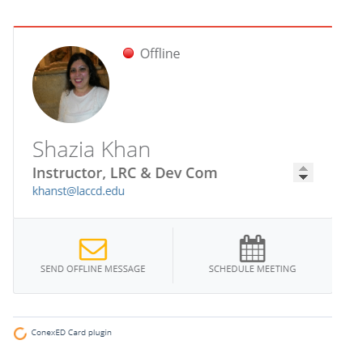
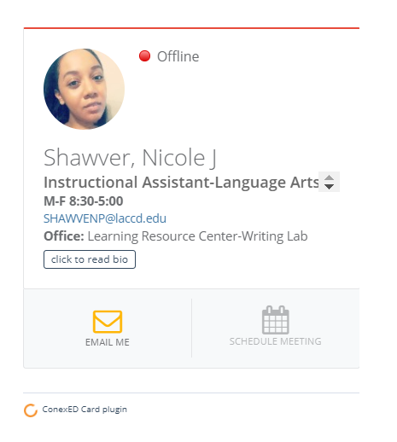
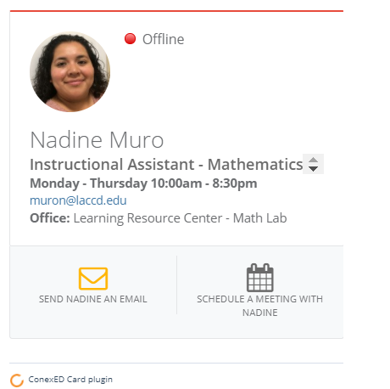
LRC Staff
Shazia Khan, Instructor
(currently on sabbatical)
Nadine Muro, Instructional Assistant (Mathematics)
Nicole Shawver, Instructional Assistant (Language Arts)

Slide 4
LRC=Learning Resource Center

Slide 5
LRC Tutoring Subjects
*Free tutoring for:
-Math
-English/ESL
-Literacy
Subject Specific: -Microbiology
(vary each semester) -Economics
-Anatomy -Physics
-Biology -Physiology
-Calculus -Spanish
-Chemistry *Available to all currently enrolled
students

Slide 6
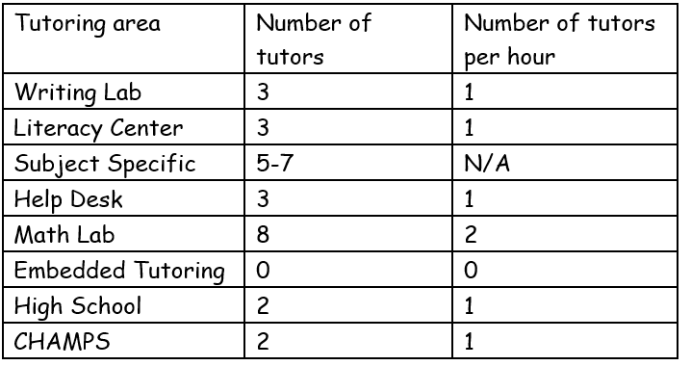
LRC Tutor Availability

Slide 7
LRC Functions
-Provide personalized academic support (tutoring) to students
-Provide resources for student success
-Work with student NOT for student
-Suggest relevant DLAs (Directed Learning Activities) when appropriate

Slide 8
How to request an appointment with an LRC tutor
Go to LRC website
Click “request tutoring from Harbor tutors”
Fill out google form
Wait for an email from the LRC
Enjoy your virtual tutoring session
LRC Website:
https://effectiveness.lahc.edu/academic_affairs/lrc/SitePages/Home.aspx

Slide 9
Go to LRC website
https://effectiveness.lahc.edu/academic_affairs/lrc/SitePages/Home.aspx

Slide 10
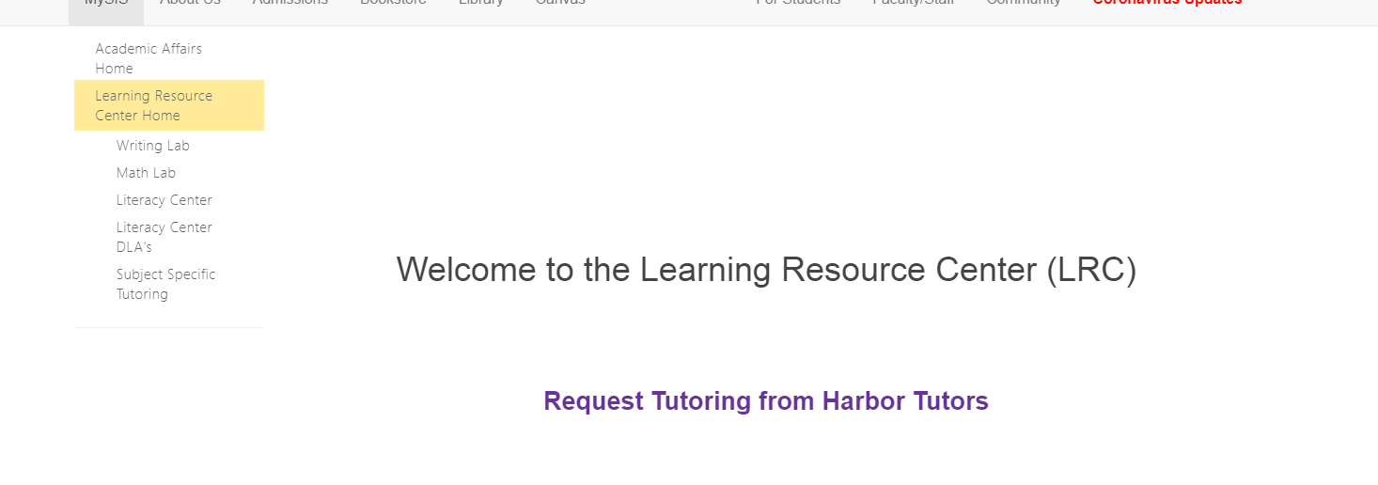
2. Click “Request Tutoring”

Slide 11
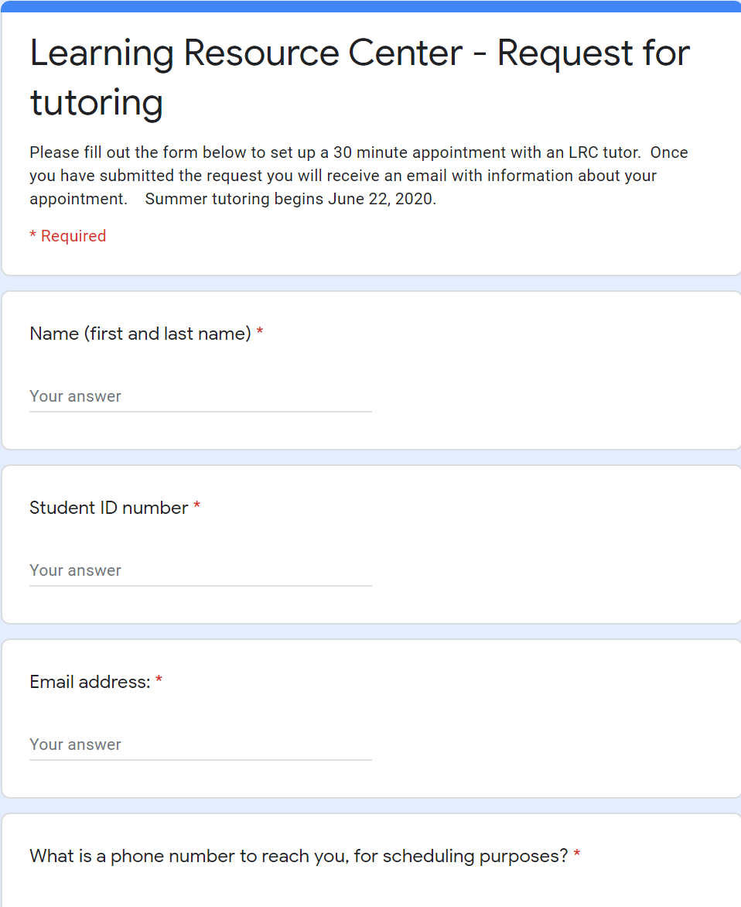
3. Fill out Google Form

Slide 12
4. Wait for confirmation email

Slide 13
5. Enjoy Your Virtual Tutoring Session via Zoom

Slide 14
LRC Usage: Fall 2018
Math Lab
Writing Lab

Slide 15
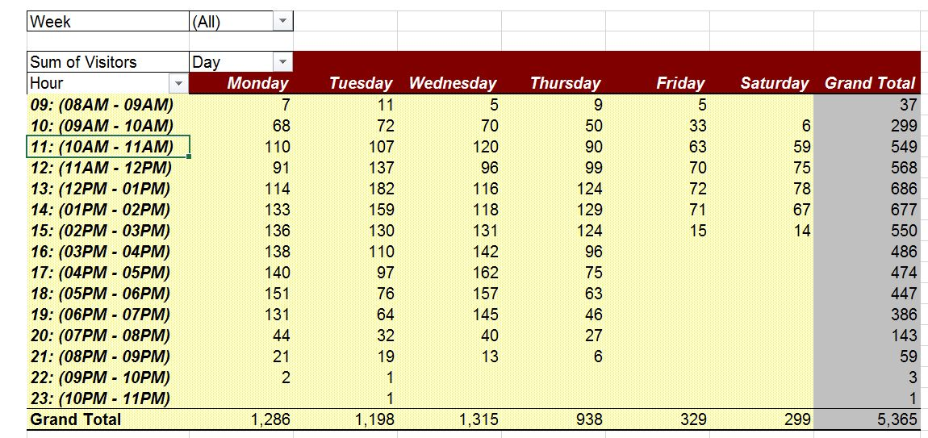
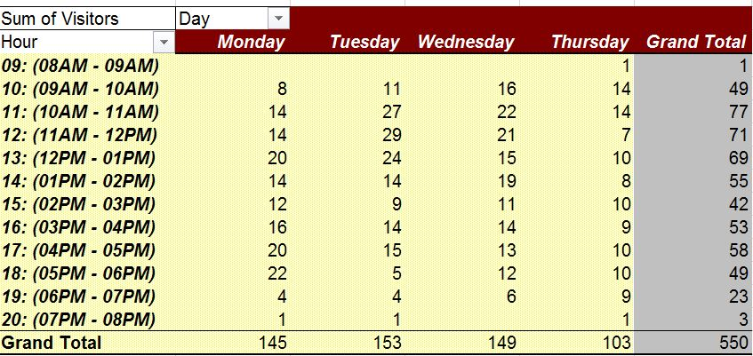
LRC Usage: Spring 2019
Math Lab
Writing Lab

Slide 16
LRC Usage: Fall 2019
Math Lab
*Data calculation in progress
Writing Lab
Total number of visits: 161

Slide 17
LRC Usage: Spring 2020
Math Lab
156 requests
134 appointments
Writing Lab
38 requests
19 appointments completed
*April 13-June 8 (remote learning)

Slide 18
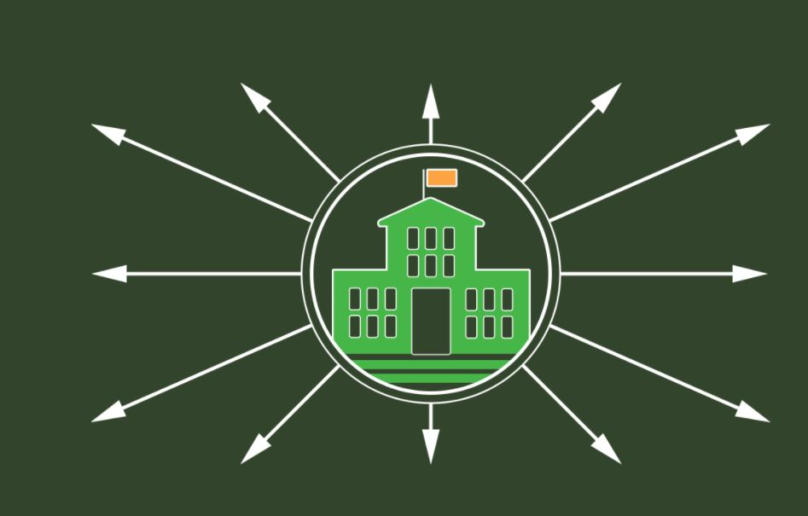
Net Tutor
-Extension of campus tutoring through third party site
-Non Harbor tutors
-24 hour tutoring for math and writing (other subjects have specific hours)
-Can be accessed through Canvas shell as long as instructor enables it
-No need for appointments as students can drop in when they are ready

Slide 19
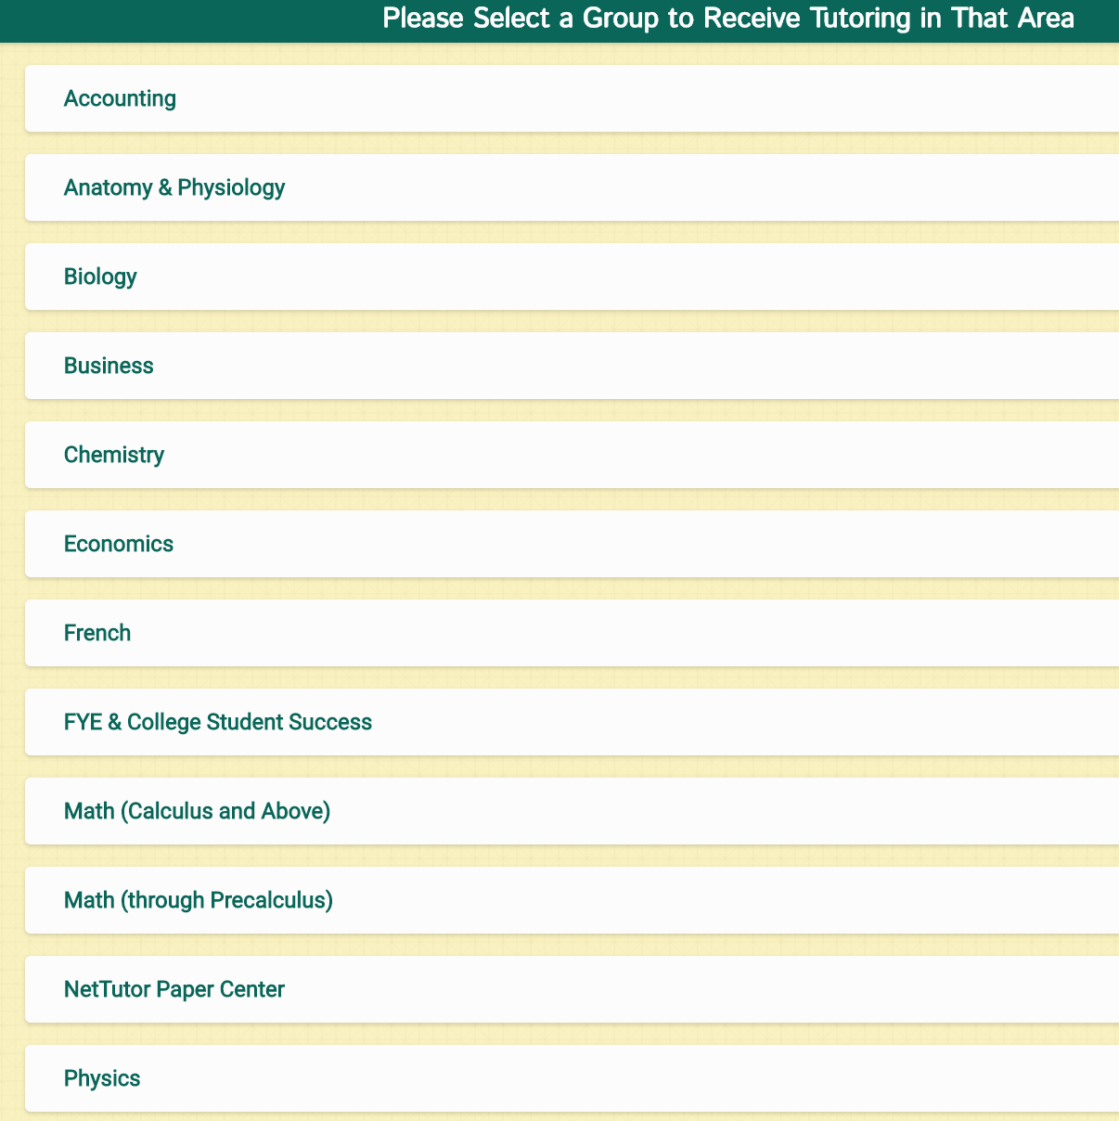
Access Net Tutor through Canvas Shell
Choose the subject needed for tutoring

Slide 20
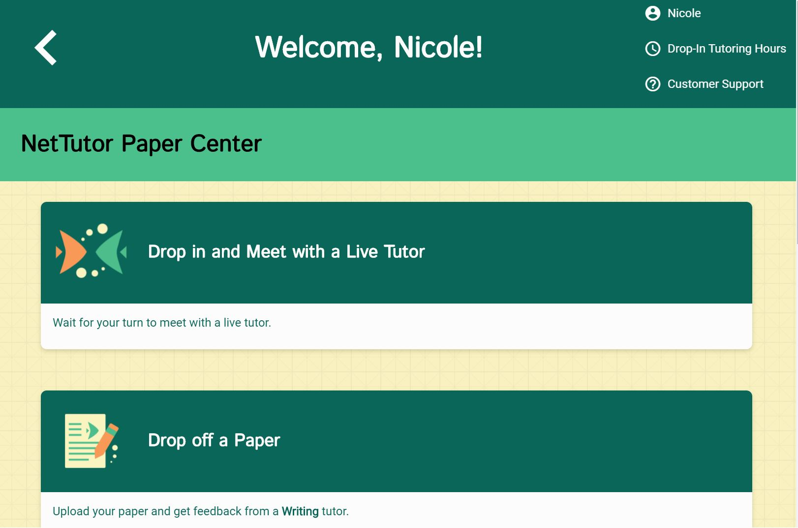
Net Tutor: Drop in with a Live Tutor
Check tutoring hours for each subject at top right

Slide 21
Net Tutor: Wait in virtual line for tutor

Slide 22
Net Tutor: Meet with Virtual Tutor
Chat with tutor
in chat box

Slide 23
Net Tutor Usage: Fall 2018

Slide 24
Net Tutor Usage: Spring 2019

Slide 25
Net Tutor Usage: Fall 2019

Slide 26
Net Tutor Usage: Spring 2020

Slide 27
LRC Tutoring vs. Net Tutor
-Through Harbor College
-Harbor Tutors who have taken classes
-Request an appointment
-Intimate knowledge of Harbor curriculum and teaching styles
-Extension of college tutoring through third party
-Non Harbor tutors
-No appointments needed

Slide 28
Thank You
Contact for more information:
Nadine Muro, muron@laccd.edu
Nicole Shawver,
shawvenp@laccd.edu

